Slide 1


DATA COMMUNICATION
CSE 225/233
WEEK-4, LESSON-1
DIGITAL TRANSMISSION

Slide 2
Digital to Digital Conversion
In this section, we see how we can represent digital data by using digital signals. The conversion involves three techniques: line coding, block coding, and scrambling. Line coding is always needed; block coding and scrambling may or may not be needed.
Topics discussed in this section:
Line Coding
Line Coding Schemes Block Coding Scrambling
Data Communication Lecture Series, NRC, MAY2020
4.2

Slide 3
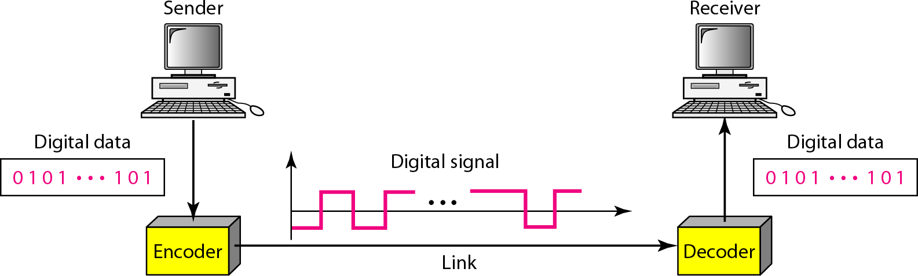
Line coding and decoding
Line coding is the process of converting binary data i.e. a sequence of bits, into a digital signal. At the sender digital data are encoded into a digital signal; at the receiver, digital data are recreated by decoding the digital signal.
4.3

Slide 4
Signal element versus data element
Difference between data element and signal element:
In data communication, the goal is to send data element.
A data element is the smallest entity that can represent a piece of information: this is the bit.
In digital data communication, a signal element carries data elements. A signal element is the shortest unit (time wise) of a digital signal.
Data elements are what we need to send; signal elements are what we can send.
Data elements are being carried; signal elements are the carriers.
4.4

Slide 5
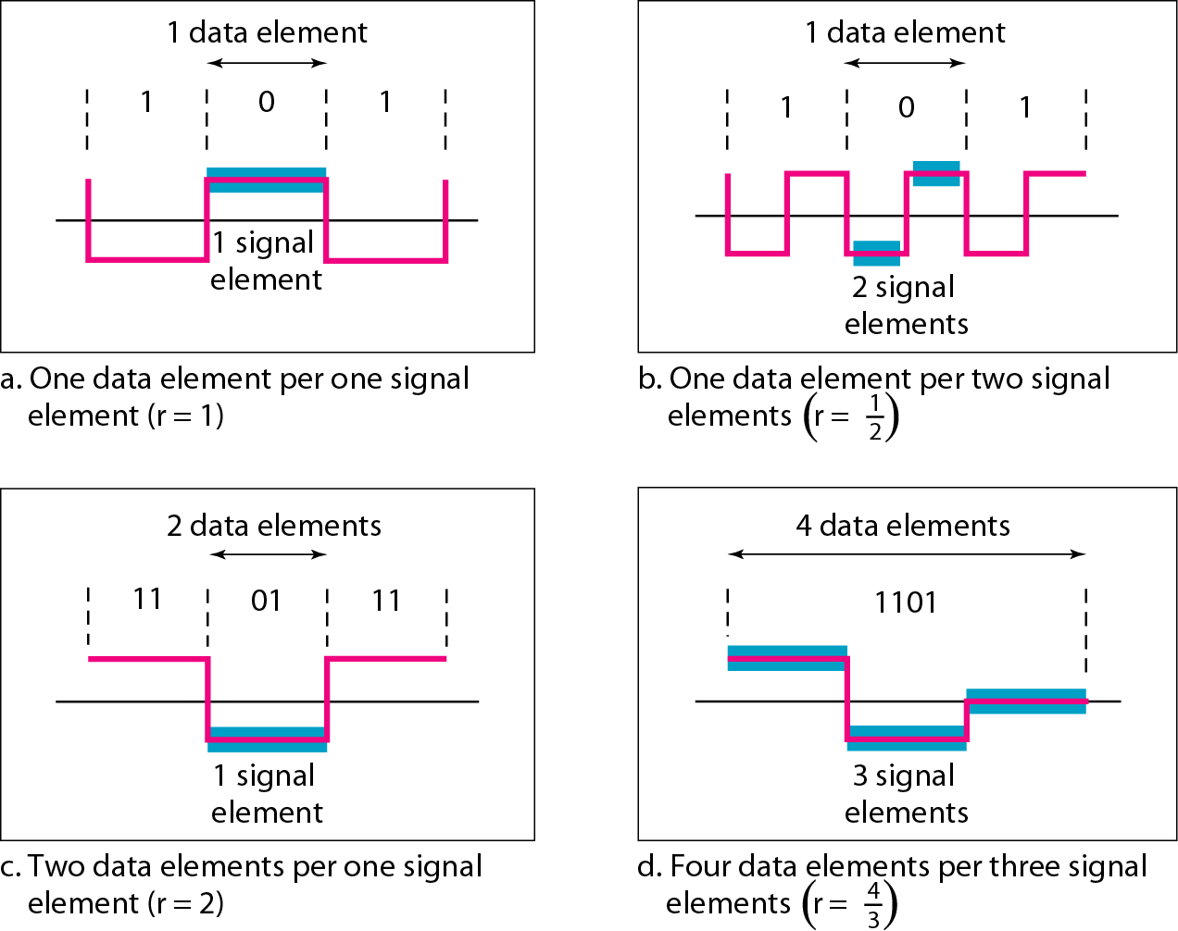
Signal element versus data element
4.5

Slide 6


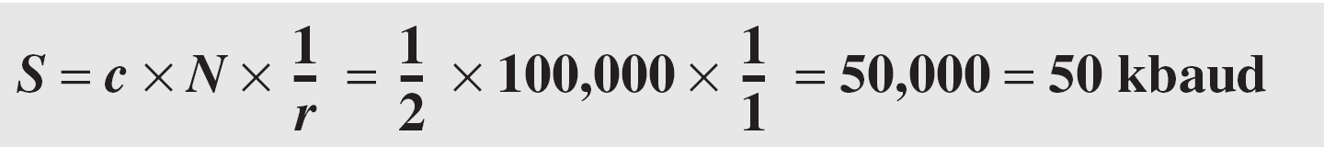

Example
A signal is carrying data in which one data element is encoded as one signal element ( r = 1). If the bit rate is 100 kbps, what is the average value of the baud rate if c is between 0 and 1?
Solution
We assume that the average value of c is 1/2 . The baud rate is then
Although the actual bandwidth of a digital signal is infinite, the effective bandwidth is finite.
4.6

Slide 7
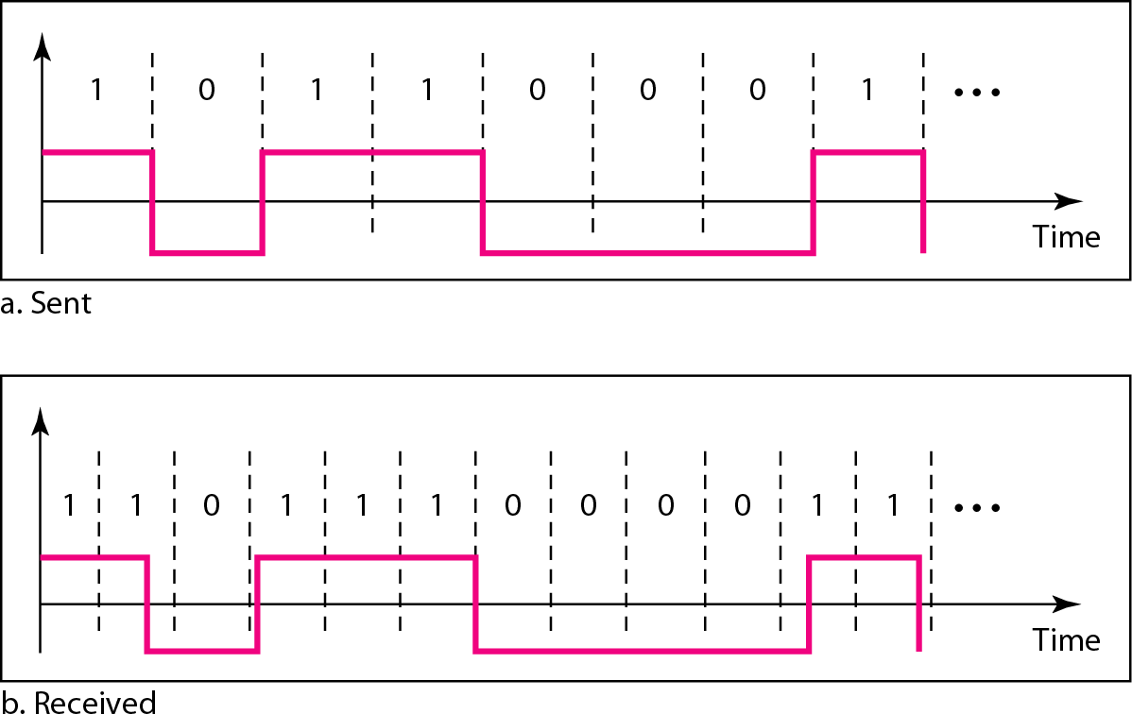
Effect of lack of synchronization
4.7

Slide 8
Example
In a digital transmission, the receiver clock is 0.1 percent faster than the sender clock. How many extra bits per
second does the receiver receive if the data rate is
1 kbps? How many if the data rate is 1 Mbps?
Solution
At 1 kbps, the receiver receives 1001 bps instead of 1000 bps.
At 1 Mbps, the receiver receives 1,001,000 bps instead of 1,000,000 bps.
4.8

Slide 9
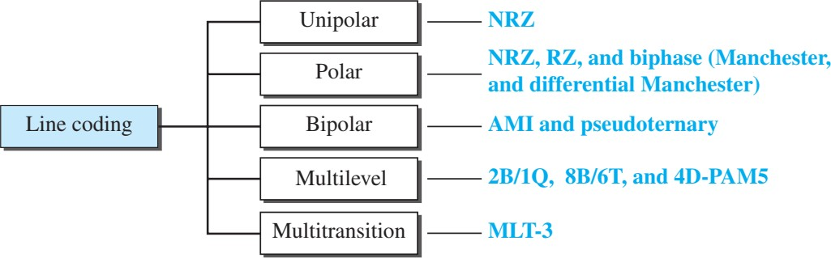
Line Coding Scheme
4.9

Slide 10
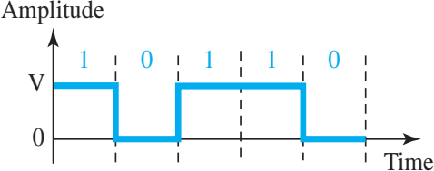
Unipolar NRZ
In a Unipolar scheme, all the signal levels are on one side of the time axis, either above or bellow.
Traditionally, a unipolar scheme was designed as a non- return-to-zero (NRZ) scheme in which the positive voltage defines bit 1 and the zero voltage defines bit 0. It is called NRZ because the signal does not return to zero at the middle of the bit.
4.10

Slide 11
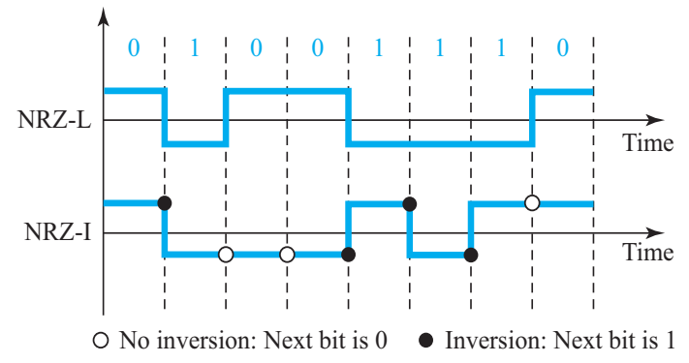
Polar Non-Return- to-Zero (NRZ)
In polar schemes, the voltages are on both sides of time axis.
In polar NRZ encoding, we use two levels of voltage amplitude. We
can have two versions of polar NRZ: NRZ-L and NRZ-I.
NRZ-L (NRZ-Level), the level of the voltage determines the value of the bit. In the second variation.
NRZ-I (NRZ-Invert), the change or lack of change in the level of the voltage determines the value of the bit. If there is no change, the bit is 0; if there is a change, the bit is 1.

Slide 12
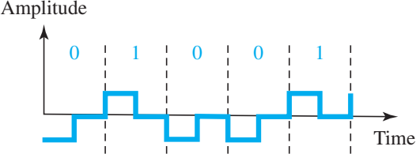
Polar RZ
In Return-to-Zero (RZ) scheme, which uses three values: positive, negative, and zero. In RZ, the signal changes not between bits but during the bit.
The main disadvantage of RZ encoding is that it requires two signal changes to encode a bit and therefore occupies greater bandwidth.

Slide 13
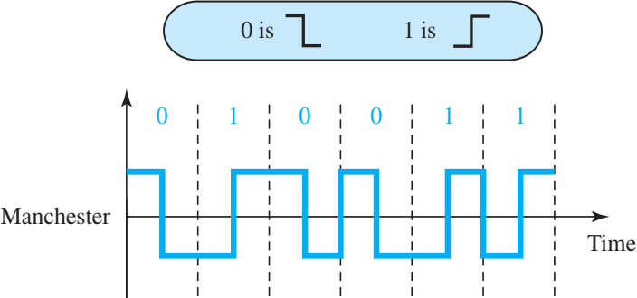
Biphase: Manchester
The idea of RZ (transition at the middle of the bit) and the idea of NRZ-L are combined into the Manchester scheme. In Manchester encoding, the duration of the bit is divided into two halves. The voltage remains at one level during the first half and moves to the other level in the second half.

Slide 14

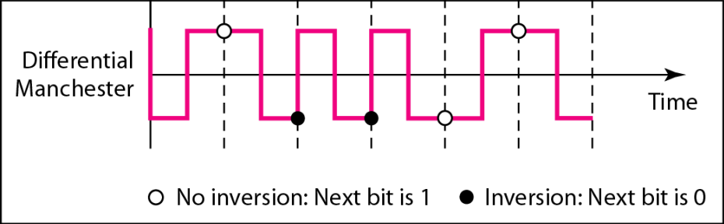
Biphase: Differential Manchester
Differential Manchester, on the other hand, combines the ideas of RZ and NRZ-I. There is always a transition at the middle of the bit, but the bit values are determined at the beginning of the bit. If the next bit is 0, there is a transition; if the next bit is 1, there is none.

Slide 15
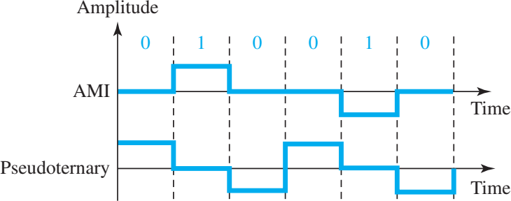
Bipolar: AMI and Pseudoternary
A common bipolar encoding scheme is called bipolar Alternate Mark Inversion (AMI). In the term alternate mark inversion, the word mark comes from telegraphy and means 1. So AMI means alternate 1 inversion. A neutral zero voltage represents binary 0. Binary 1s are represented by alternating positive and negative voltages. A variation of AMI encoding is called Pseudoternary in which the 1 bit is encoded as a zero voltage and the 0 bit is encoded as alternating positive and negative voltages.

Slide 16
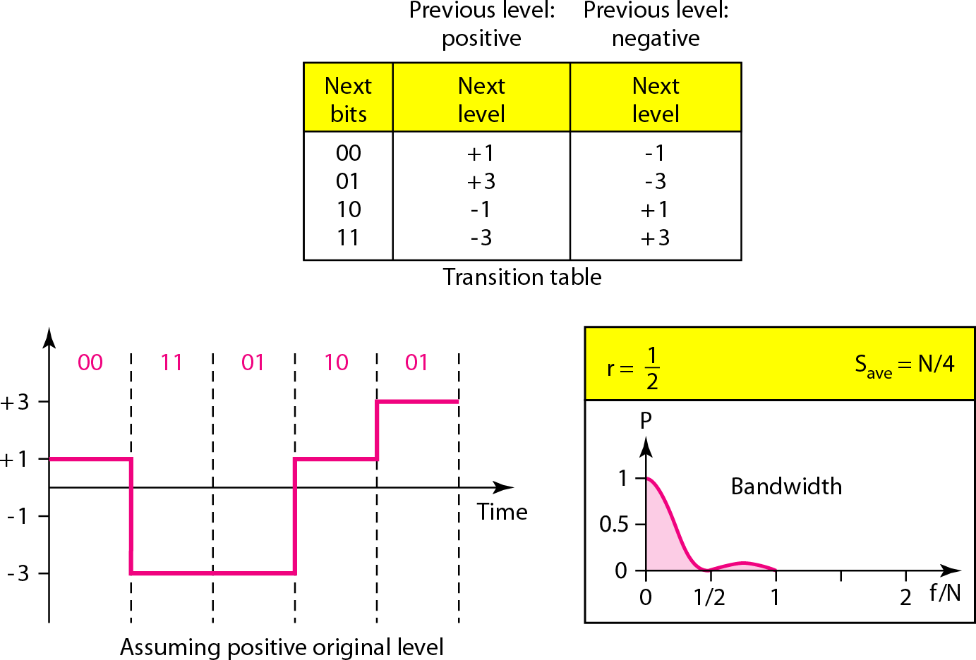
Multilevel: 2B1Q Scheme
Two binary, one quaternary (2B1Q), uses data patterns of size 2 and encodes the 2-bit patterns as one signal element belonging to a four-level signal. In this type of encoding m = 2, n = 1, and L = 4 (quaternary).

Slide 17
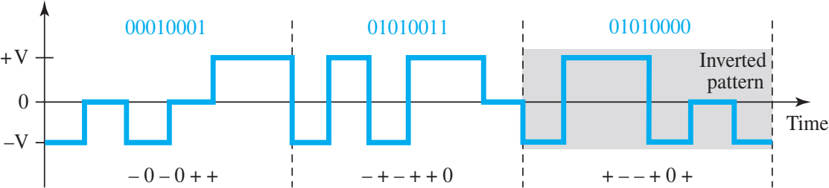
Multilevel: 8B6T Scheme
A very interesting scheme is eight binary, six ternary (8B6T). This code is used with 100BASE-4T cable. The idea is to encode a pattern of 8 bits as a pattern of six signal elements, where the signal has three levels (ternary).

Slide 18
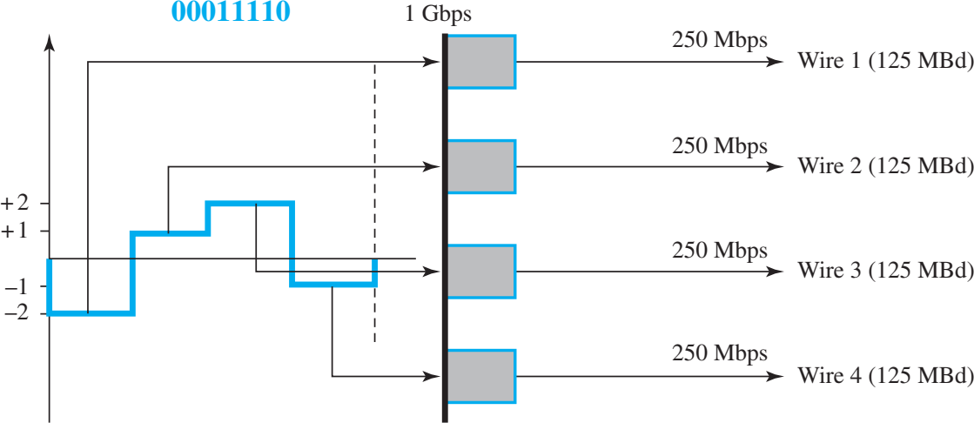
Multilevel: 4D-PAM5
In Four-dimensional five level pulse amplitude modulation (4D- PAM5). The 4D means that data is sent over four wires at the same time. It uses five voltage levels, such as −2, −1, 0, 1, and 2. However, one level, level 0, is used only for forward error detection.

Slide 19
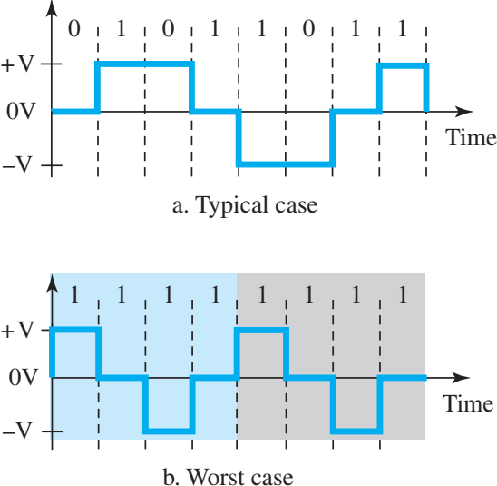
Multitransition: MLT-3 scheme
The multiline transmission, three-level (MLT-3) scheme uses three levels (+V, 0,
and −V) and three transition rules to move between the levels.
If the next bit is 0, there is no transition.
If the next bit is 1 and the current level is not 0, the next level is 0.
If the next bit is 1 and the current level is 0, the next level is the opposite of the
last nonzero level.

Slide 20
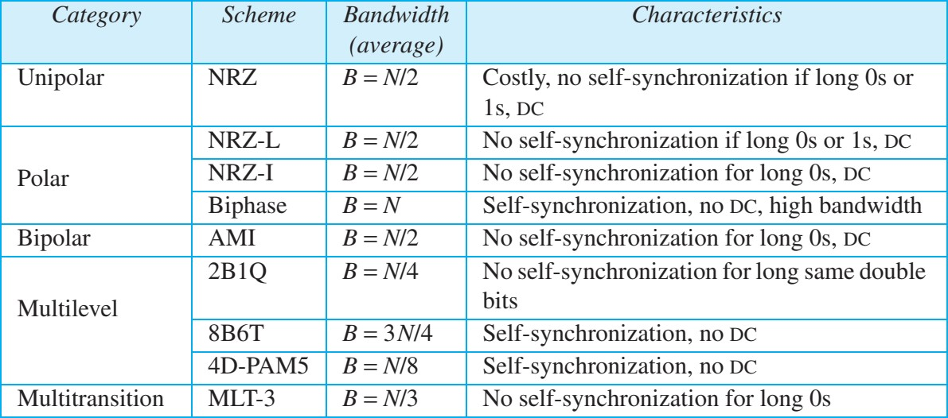
Summary: Line Coding Schemes

Slide 21
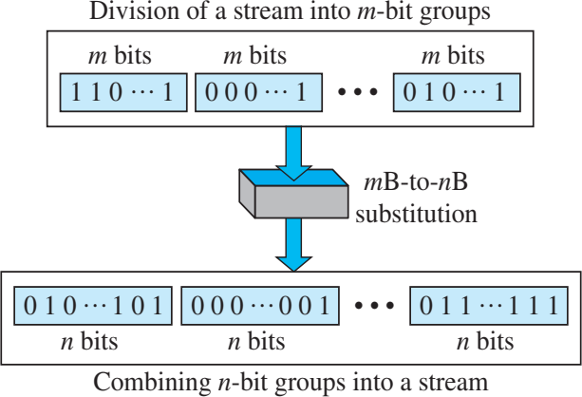
Block Coding
We need redundancy to ensure synchronization and to provide some kind of inherent error detecting. Block coding can give us this redundancy and improve the performance of line coding. In general, block coding changes a block of m bits into a block of n bits, where n is larger than m. Block coding is referred to as an mB/nB encoding technique.
Concept:

Slide 22
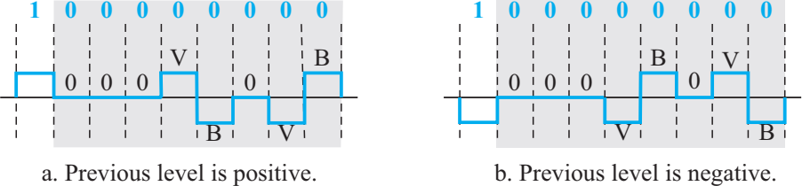
Scrambling: B8ZS
Bipolar with 8-zero substitution (B8ZS) is commonly used in North America. In this technique, eight consecutive zero-level voltages are replaced by the sequence 000VB0VB. The V in the sequence denotes violation; this is a nonzero voltage that breaks an AMI rule of encoding (opposite polarity from the previous). The B in the sequence denotes bipolar, which means a nonzero level voltage in accordance with the AMI rule. There are two cases. See the picture below.

Slide 23
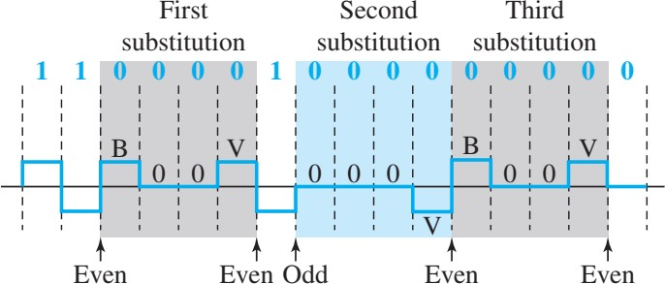
Scrambling: HDB3
High-density bipolar 3-zero (HDB3) is commonly used outside of North America. In this technique, which is more conservative than B8ZS, four consecutive zero level voltages are replaced with a sequence of 000V or B00V. The reason for two different substitutions is to maintain the even number of nonzero pulses after each substitution. The two rules can be stated as follows:
If the number of nonzero pulses after the last substitution is odd, the substitution
pattern will be 000V, which makes the total number of nonzero pulses even.
If the number of nonzero pulses after the last substitution is even, the substitution pattern will be B00V, which makes the total number of nonzero pulses even.

Slide 24

Data Communication Lecture Series, NRC, MAY2020
4.23

